Slide 1

Welcome to
our lesson

Slide 2

The outline of the lesson
I. Organization moment
1. greeting
- Good afternoon!
- Take your seats
- Who is on duty today ?
- Who is absent?
- What is the weather like?
- What’s your home task?

Slide 3
Aims of the lesson
а) To get acquainted pupils with new theme.
в) Tо enlarge pupils outlook with the variety of people in the world.
с) To develop pupils speaking ,listening skills.
Aims of knowledge:
The type of the lesson:
different
Metods of the lesson:
answer –question
Connectional lesson:
kazakh, geography, music.
Visual aids:
interactive-board,card,map.

Slide 4

III. Checking-up homework
Do you want some Pepsy?

Slide 5

II. Phonetic drill
Where are you from?
Where are you from?
Can you tell me ,please.?
Where are you from?
I am from London
I am from China
I am from Kazakhstan.
I live here.

Slide 6





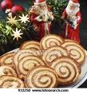

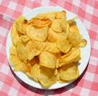
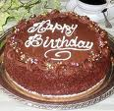

SHOPIHG
i
s

Slide 7

H
a
m
b
u
r
g
e
r
c
o
k
e
i
s
o
r
a
n
g
e
j
u
i
c
e
b
i
s
c
u
i
t
c
h
e
e
s
e
c
h
i
p
s
c
a
k
e
l
e
m
o
n
a
d
e

Slide 8
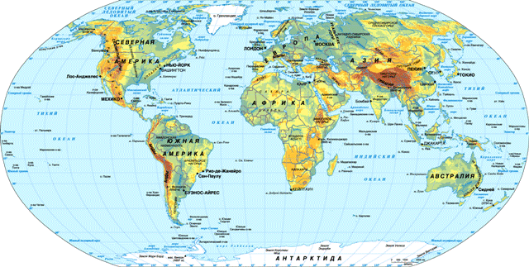
IV. To explain the
new material.
II.TRAVELLING

Slide 9

NEW WORDS.
Nationality-ұлт
American- американдық
English- ағылшын
Chinese -қытайлық
Japanese -жапондық
Italian -итальяндық
Russian -орыс
Kazakh- қазақ.

Slide 10
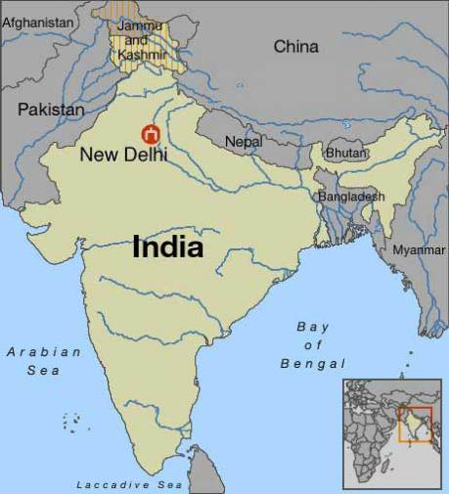
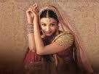
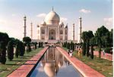
She is Indian.

Slide 11

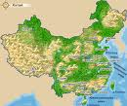
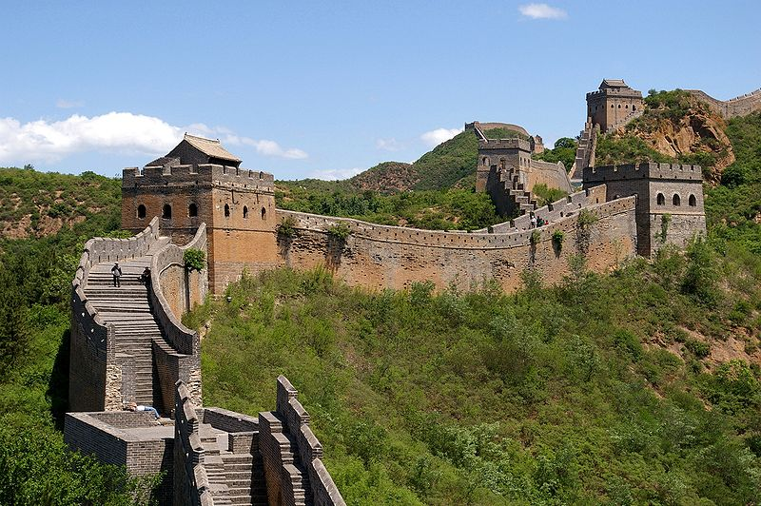
2.CHINA
She comes from China.
She is Chinese.

Slide 12
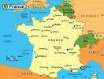

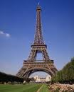
3.France.
He comes from France
He is French

Slide 13
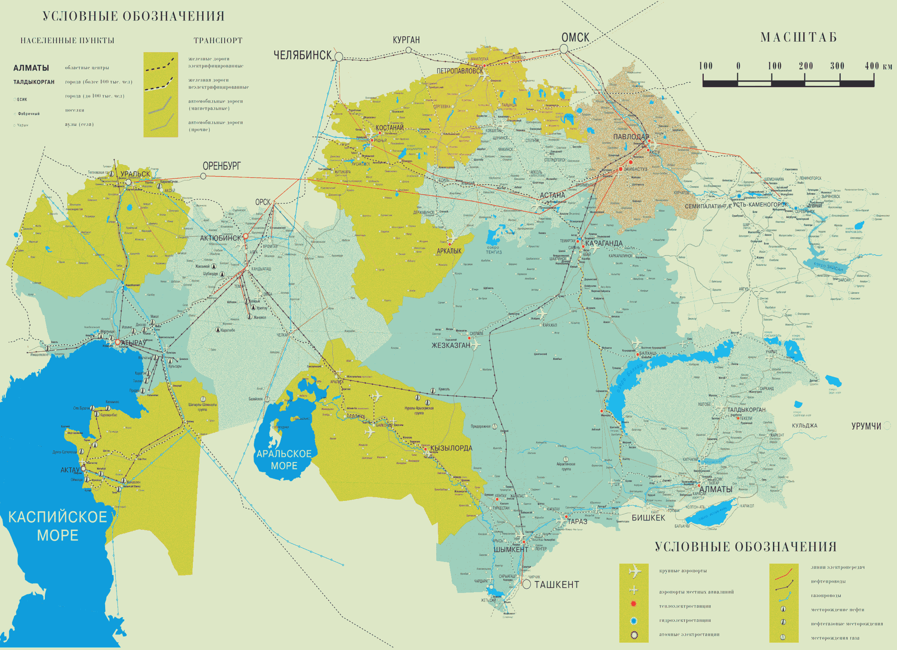

Slide 14

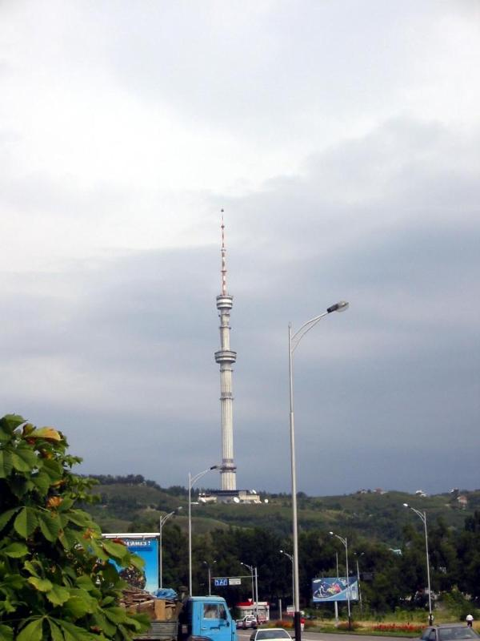
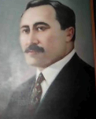
4.Kazakhstan.
He is Kazakh.

Slide 15


5.Turkey.
She comes from Turkey
She is Turkish

Slide 16
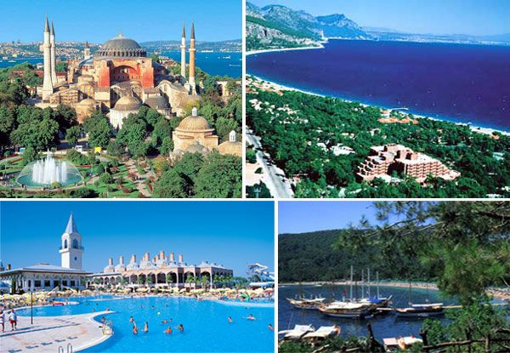

Slide 17
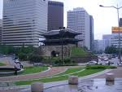
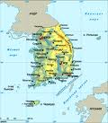
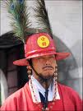
6. Korea.
He comes from Korea.
He is Korean

Slide 18
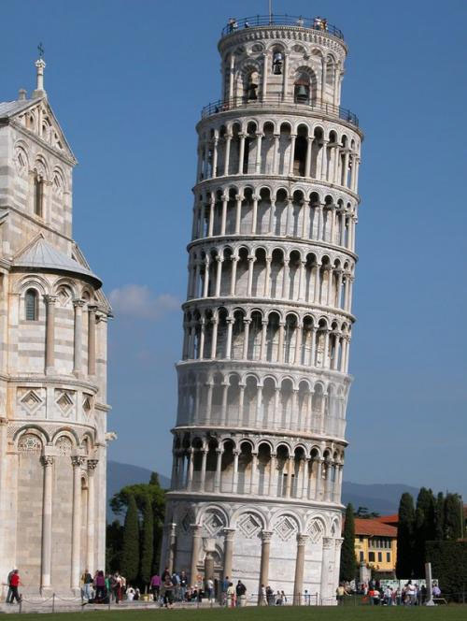

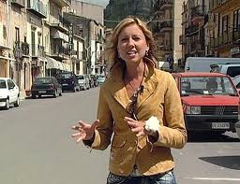
7.Italy.
She comes from Italy.
She is Italiane

Slide 19
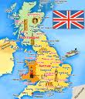


8.Great Britain
He comes from Great Britain.
He is English

Slide 20



9.The USA.
He comes from the USA.
He is American

Slide 21
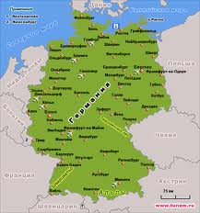
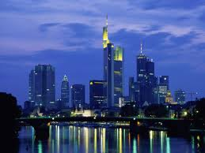
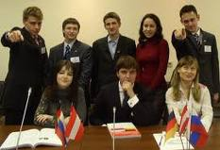
10Germany.
They comes from Germany
They are German

Slide 22
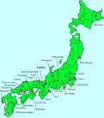
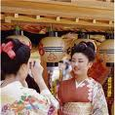

11. JAPAN.
She comes from Japan.
She is Japanese

Slide 23


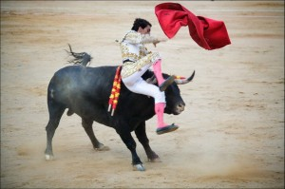
12.Spain.
She comes from Spain.
She is Spanish

Slide 24

IV.TRAINING EXERCISE
IF YOU HAPPY

Slide 25

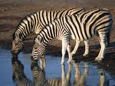



Zebra
Bear
Giraffes
Camel

Slide 26

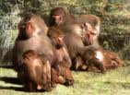
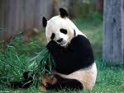

Panda
Monkeys.
Tiger

Slide 27


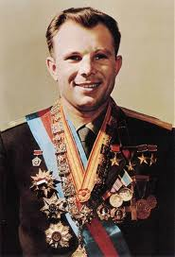

V. Consolidation of the lesson.
CARD 1.
a. -Where does Michael Jackson come from?
- …….comes from ……………..
b. –Where does Yury Gagarin come from?
- He comes from …………….
c. –Where does Go Jun Pyo come from?
- He comes from ……………..

Slide 28

Write countries and nationalities.
b. Korea----`1
a. The USA---
c. Spain---
e. Turkey -
d. France---

Slide 29

CARD 3.
a.-Where do elephants live?
They live in …………
.
c.- Where do kangaroos live?
- They live in …………
b.- Where do camels live?
- They live in ………..

Slide 30
VII.Giving the homework.
Ex-15 Write about famous people.
Ex-16.write countries and nationalities.

Slide 31

VIII. Putting marks.
That’s all for today .Thank you for your work.
You were active and friendly today
Together, together.
Together every day.
Together, together
We work and play

Slide 32
The lesson is over.
You are free .
Good- bye

