Slide 1
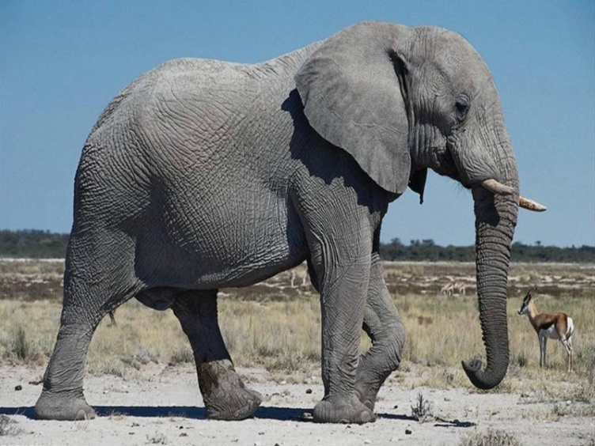
ABOUT Animals
7 а сынып
Пән мұғалімі Ж.Т.Мамбеталиева

Slide 2
Animals
Wild animals:
A lion
A tiger
A bear
A fox
A wolf
A monkey
A giraffe
An elephant
A squirrel
A hare
Domestic animals:
A dog
A cat
A cow
A sheep
A horse
A pig
A parrot

Slide 3
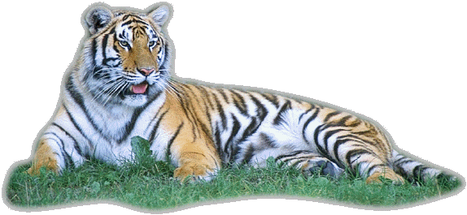
Habitat
Vast
Wild
Domestic
Fur
Feather

Slide 4



Slide 5
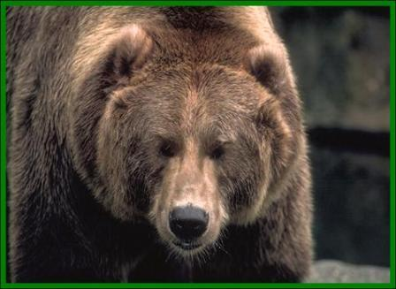
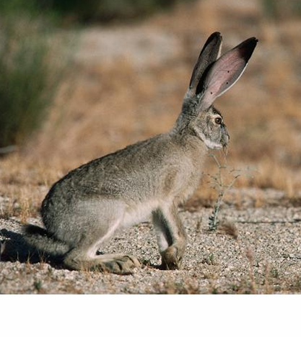
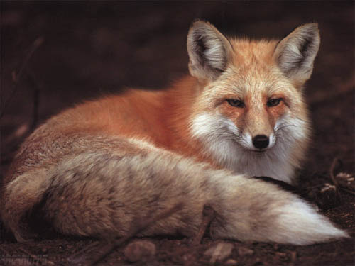
Who is it

Slide 6
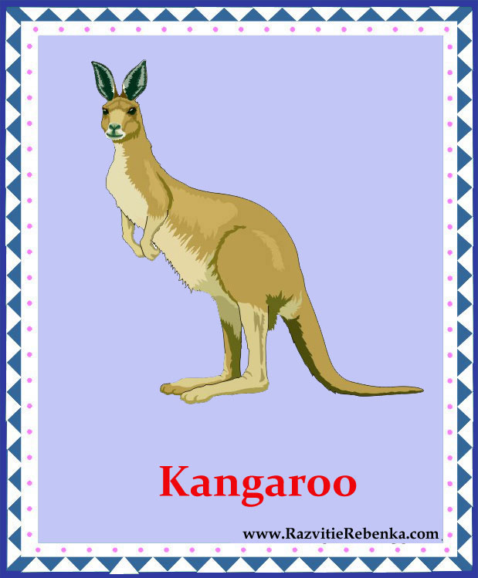
This animal lives in Australia. The mother carries her babies in her pouch.

Slide 7
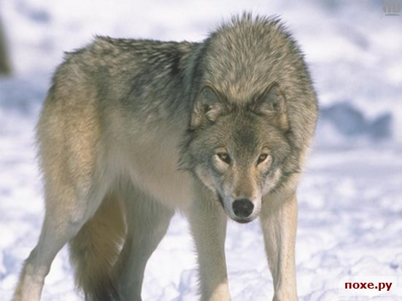
This wild animal is allied to a dog.

Slide 8
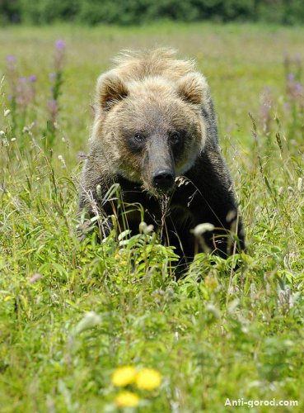
his big brown animal lives in the forest. It likes honey.

Slide 9
This animal is known for its cunning.

Slide 10
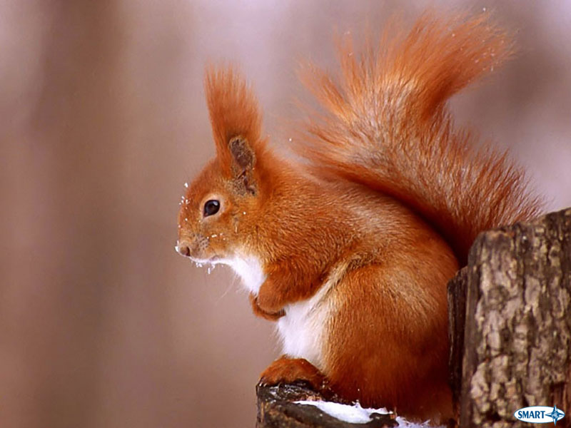
This little animal stores up nuts for the winter.

